Slide 1
Data Acquisition: Weather Monitoring Station

Slide 2
an object-oriented solution to a real-time control processing application
provides a reusable component architecture
isolate the hardware from the application

Slide 3
Inception

Slide 4
Requirements for the Weather Monitoring Station
Specifically, it must measure the following:
Wind speed and direction
Temperature
Barometric pressure
Humidity

Slide 5
Requirements for the Weather Monitoring Station
The system shall also provide these derived measurements:
Wind chill
Dew point temperature
Temperature trend
Barometric pressure trend

Slide 6
The system shall have a means of determining the current time and date
It can report the highest and lowest values of any of the four primary measurements during the previous 24-hour period

Slide 7
The system shall have a display that continuously indicates all eight primary and derived measurements
current time and date
Through the use of a keypad
the user may direct the system to display the 24-hour high or low value of any one primary measurement
time of the reported value

Slide 8
The system shall allow
the user to calibrate its sensors against known values
to set the current time and date

Slide 9
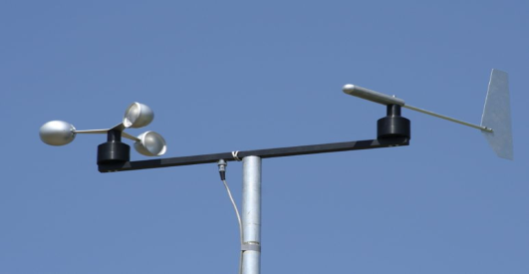
Defining the Boundaries of the Problem
h/w assumptions
CPU may take the form of a PC or a handheld device
Time and date are supplied by a clock
Temperature, barometric pressure, and humidity are measured via remote sensors
Wind direction and speed are measured from a boom encompassing a wind vane (capable of sensing wind from any of 16 directions) and cups (which advance a counter for each revolution)
User input is provided through a keypad
The display is an off-the-shelf LCD graphic device
A timer interrupts the computer every 1/60 second

Slide 10
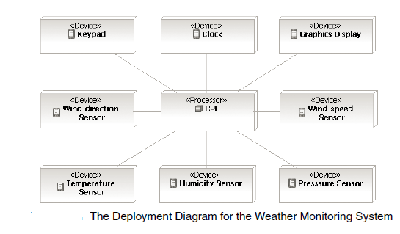

Slide 11
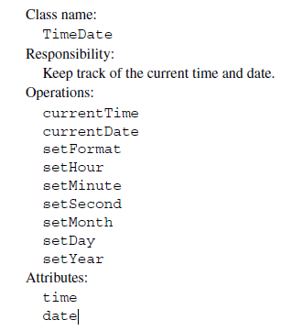
class analysis
simple class for accessing the current time and date

Slide 12
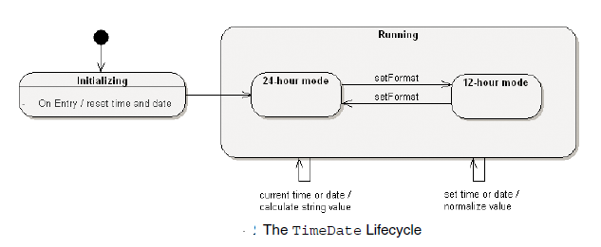
class analysis

Slide 13
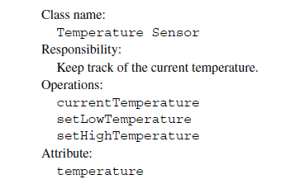
class analysis

Slide 14
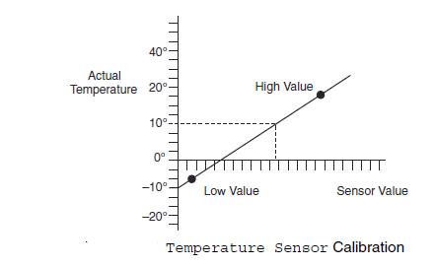
class analysis

Slide 15
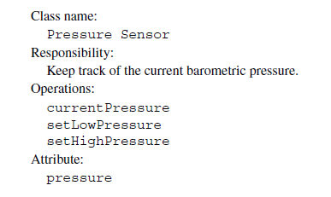
class analysis

Slide 16

Trend Sensor

Slide 17
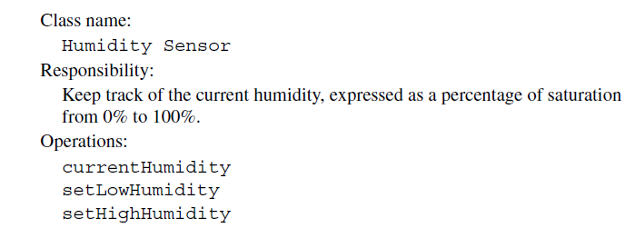


Slide 18
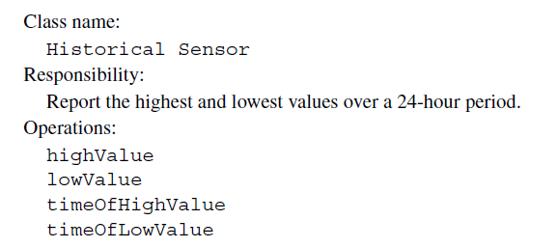

Slide 19
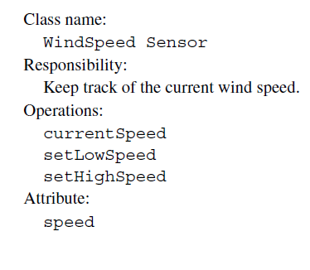

Slide 20
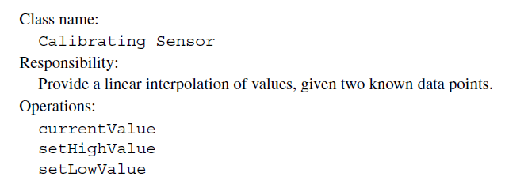

Slide 21

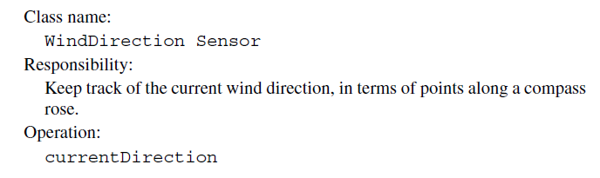


Slide 22
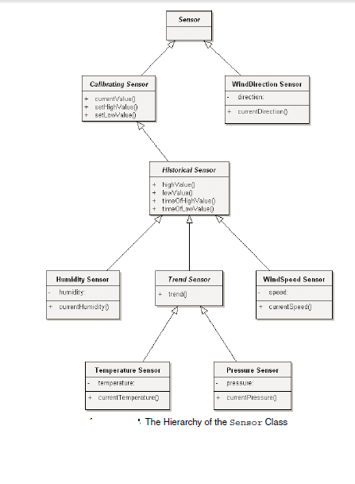

Slide 23
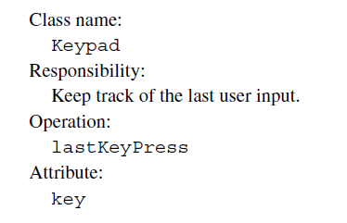

Slide 24
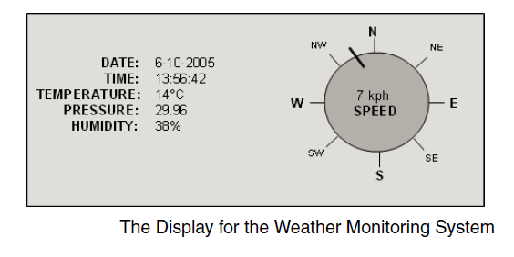

Slide 25
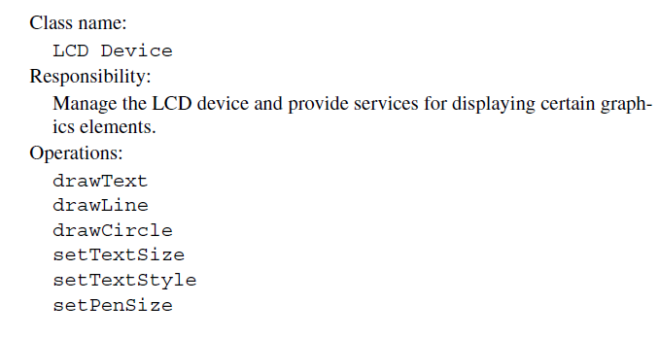

Slide 26
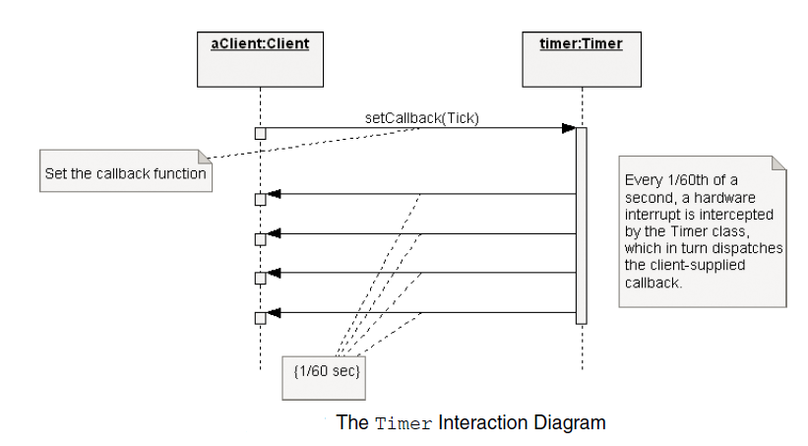

Slide 27
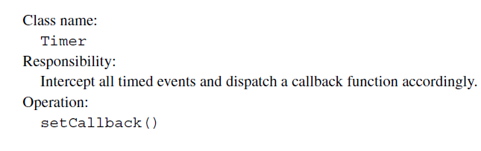

Slide 28
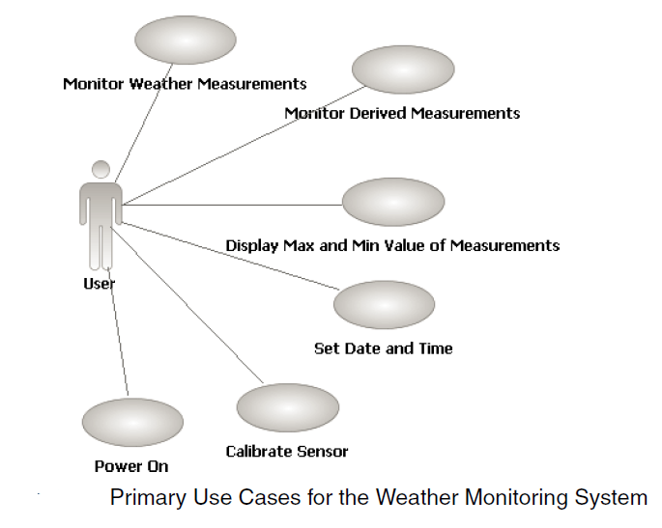
Scenarios

Slide 29
Scenarios
We add to this list two secondary use cases:
■ Power failure
■ Sensor failure

